Slide 1
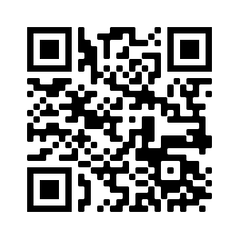
Intro to ML in Python
By the Aggie Data Science Club :)

Slide 2
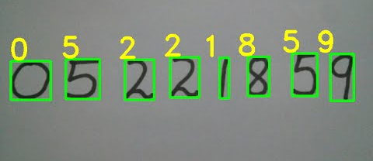
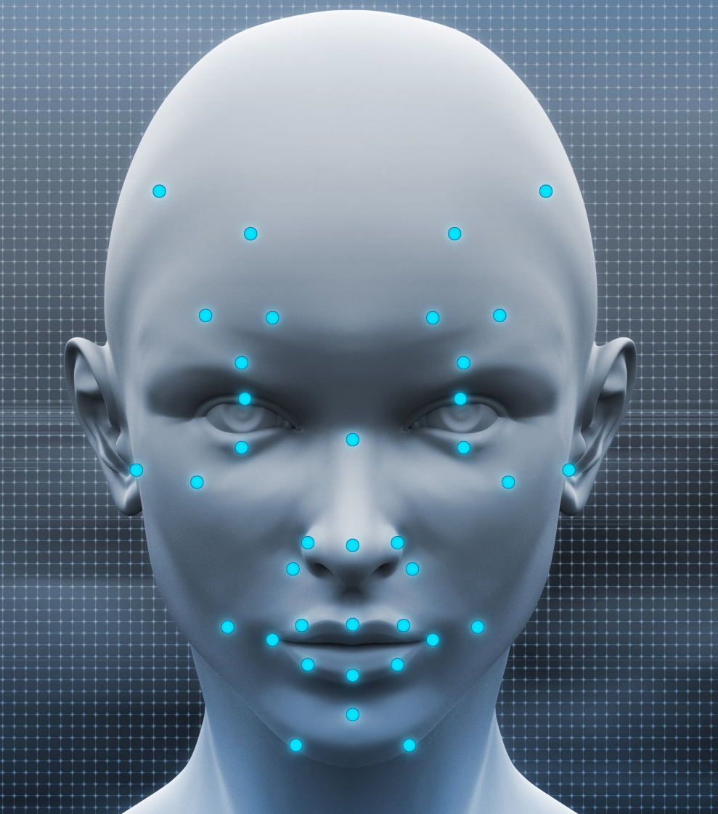
Real-World Applications
Optical Character Recognition
Facial Recognition
Autonomous Self-Driving Vehicles
Recommendation Engines in Netflix / Youtube / Amazon
Personal Assistants (Alexa, Siri, Google)
Notes:
Shreeman: Ask club members to name other real-world applications at the end

Slide 3
What is ML?
Models that detect patterns in data and make predictions on future patterns with a degree of uncertainty
0% accuracy can be as bad as 100% accuracy
Data can be numeric or non-numeric
The performance of Task T as measured by performance measure P improves with Experience E
Task: Classify whether a reader should receive an article or not
Experience: Identify personal preferences and demographics of users
Performance: % of users who read the article in their recommendations
Notes:
Shreeman: Ask bullet point why: 0% accuracy is bad data or lack of good model, 100% accuracy could be overfitting to training data

Slide 4
Types of ML
Supervised
Uses labelled data to make predictions
Applications: Image Classification, Sentiment Analysis, Spam Detection, Price Predictions
Unsupervised
Finds hidden patterns in data without labelled outputs
Applications: News clustering, Recommendations, NLP, Anomaly Detection
Reinforcement
Continuously achieves optimal behavior through user action and corresponding reward/penalty
Applications: Robot Navigation, Self-Driving Cars, Chess Engines
In reality, we would have more than one type of ML in an application.
Consider you get an email of a daily newsletter with personalized recommendations?
Consider you liking or disliking an article?
Notes:
Shreeman: The consider questions will engage audience to identify which type of learning we fall under.

Slide 5
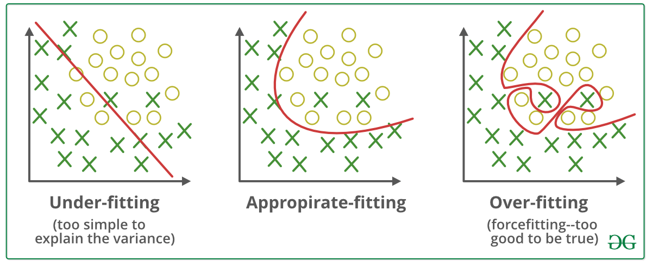
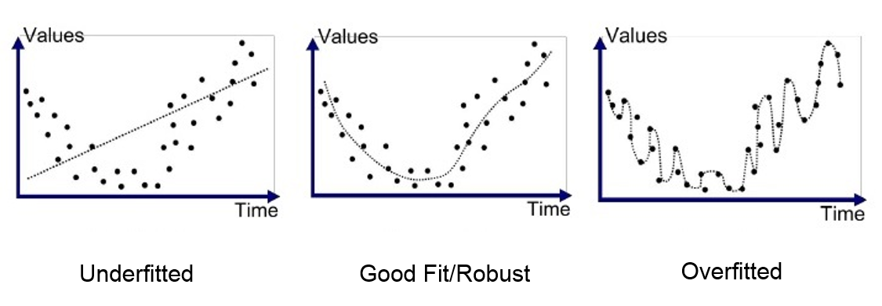
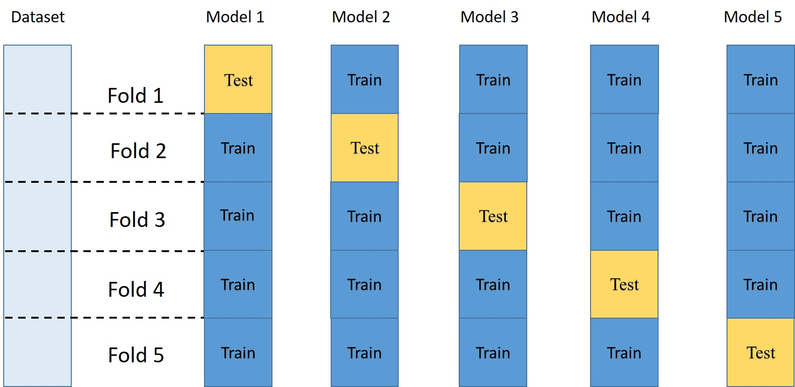
Reason why ML models fail
Overfitting
Cannot generalize beyond the training set data
Model just cannot be 100% accurate
Can be avoided by Cross-Validation
Bad data
Insufficient Data Points for number of features
Unnecessary features not removed
Biased Dataset
Sample Bias
Historical Bias
Not all bias is bad!
Notes:
Shreeman: The consider questions will engage audience to identify which type of learning we fall under.
Sample Bias: unrepresentative of the population
Historical Bias: reflects historical biases in discriminations -> ML begins accelerating divisions in society
Not all bias is bad: Useful for specific interest group applications / personalization -> Effect of consuming insulin on diabetic individuals (you would not need general population)
Much of student research here states requirements for this very reason (reduce bias / promote good bias only)

Slide 6
Types of Models

Slide 7
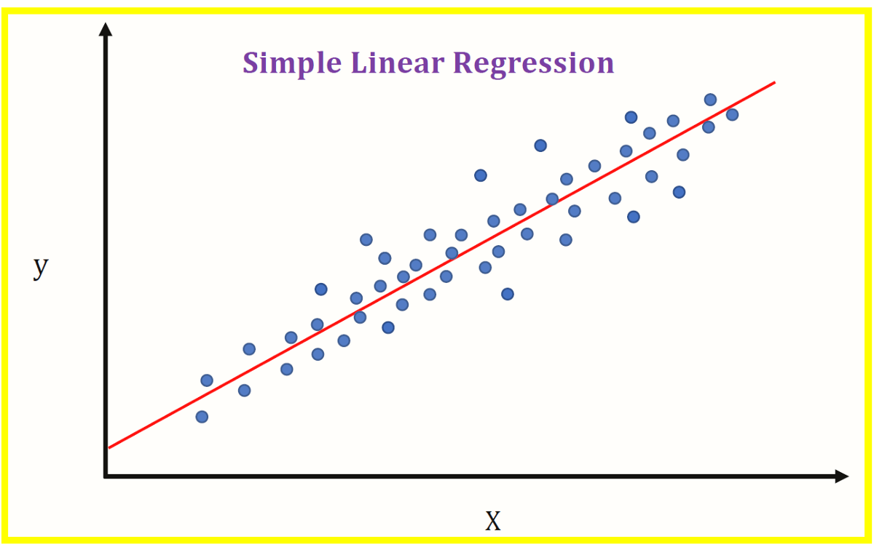
Linear Regression
Linear model
Simple, easy to explain
Provides continuous output
Multiple loss functions, but ordinary least squares and ridge regression are the most common

Slide 8
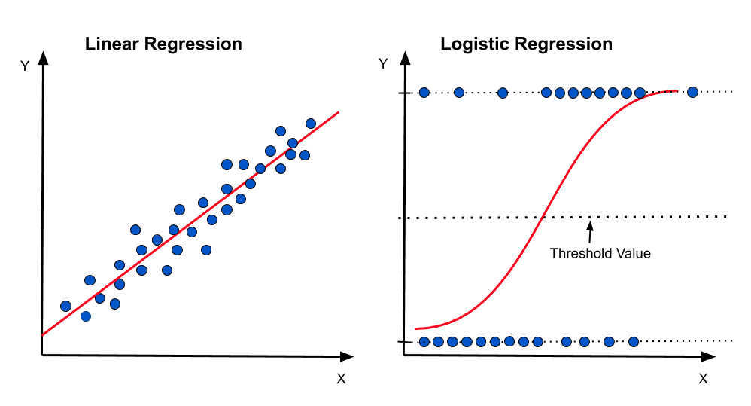
Logistic Regression
Not actually regression
Outputs a probability
Above 50%, class is 1, below 50%, class is 0
Very simple and well performing
Oftentimes as good as very complicated models
Explainable

Slide 9
Example use cases for logistic regression
Determining if someone should get a loan
Classifying email as spam or not spam
Determining whether or not someone died on the titanic

Slide 10
Loss Functions
All ML models are based around minimizing a loss function (also known as objective function)
Different loss functions for different methods and tasks

Slide 11
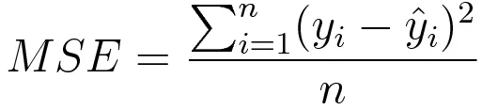
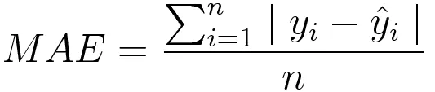
Common Loss Functions (Regression)
AKA L2 loss. Sensitive to outliers, but easier to compute
AKA L1 loss. Harder to compute, but more resistant to outliers

Slide 12
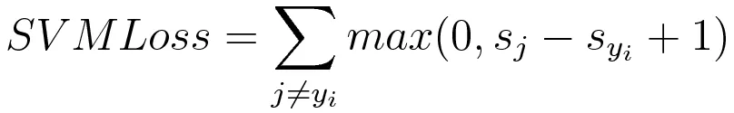
Common Loss Functions (Classification)

Slide 13
Decision Trees
Decide on splitting criteria based on Gini information gain or Shannon entropy
Very interpretable
At inference time, follow the decision tree

Slide 14
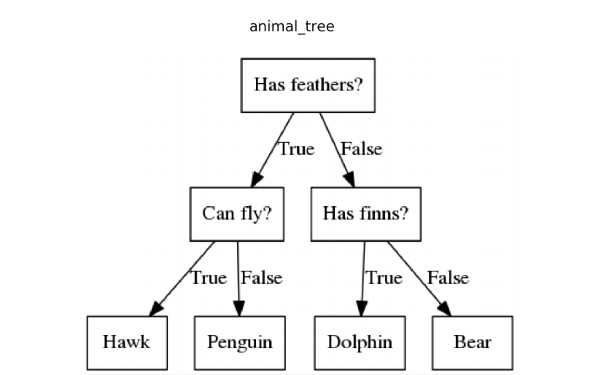

Slide 15
